Slide 1


Analysis of financial indicators of creditworthiness
Analysis prepared by: Skobelev Aleksandr
HSE, 2023

Slide 2

НИУ ВШЭ
Information about the company
Scope | Russian retail of household appliances and electronics, online trading platform
Period of operation | 1993 to present
At the moment | 1 074 stores 279 cities of Russia
*PJSC M.Video (M.Video-Eldorado Group) includes two brands: M.Video and Eldorado.

Slide 3
НИУ ВШЭ
History
2000 - online store www.mvideo.ru launched
Introduction of a new format of stores "hypermarket" - 2004
2007 - opening of the 100th store, the first among competitors to enter the IPO
Opening of the 200th store - 2010
2012 - opening of the first store not in Moscow
Opening of the 300th store - 2013
2016 - the project "M.Mobile" was launched
Merger of M.Video with Eldorado- 2018

Slide 4
НИУ ВШЭ
Controls
General Meeting of Shareholders
Board of Directors (9 members, including 3 independent directors)
Chief Executive Officer
Elects the Board of Directors Elects the Audit Commission Approves the External Auditor
Forms a development strategy and monitors its implementation Approved by the Corporate Secretary Approved by the Internal Audit Unit Elects the Director General
Carries out operational management

Slide 5
НИУ ВШЭ
Business model
Multi-channel 2012
Omnichannel 2014 - 2018
ONE RETAIL
2018 - 2022
Expansion of the traditional retail network through an online store and a call center
Increasing the geography of online business and the development of an online service
Growing an assortment of prices and approaches to online and offline sales; Development of online marketing.
A single digital retail environment with seamless transition between sales channels; A single vision of the client at all points of interaction with customers; Solutions based on data analysis, machine learning, VR and AR technologies.

Slide 6

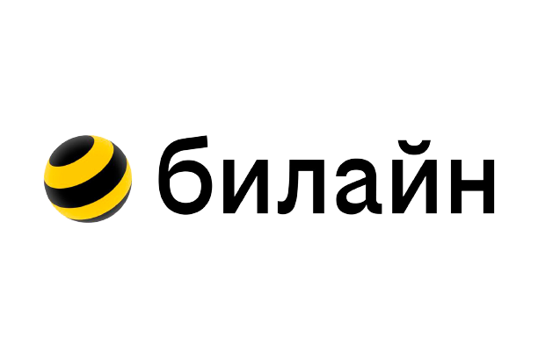


НИУ ВШЭ
Competitors
 | Revenue, billion rubles. | Profit, billion rubles. | Shops, pcs. | Cities, pcs.
DNS | 562 | 24,9 | > 2 200 | > 1 000
Ситилинк | 0,5 | 0,036 | > 650 | > 360

Slide 7

НИУ ВШЭ
The impact of business processes on financial performance
For the sale of goods and services, the company needs retail space
43% of non-current assets are assets in the form of rights of use lease liabilities, averaging 66% of the company's total long-term liabilities for the available period 2019-2021
The main activity of the company is the sale of electronics and household appliances
69% of current assets are inventory assets; the indicator of trade accounts payable is 74% of all short-term liabilities of the company cash and cash equivalents accounted for only 6% of current assets.

Slide 8
НИУ ВШЭ
The impact of business processes on financial performance
Growth of promotional activity against the background of increasing price pressure from competitors in the online segment; Spot purchases to maintain high sales growth, sufficient assortment and inventories against the background of the continuing shortage of certain categories and models of equipment and electronic components; Growth in the share of digital categories (smartphones, laptops and other products for the home office), the margin of which is below the average for the group; Increase in the cost of the logistics component in purchase prices.
The fall in M.Video's profit in 2021 by more than 65.7% compared to 2020

Slide 9
НИУ ВШЭ
The impact of business processes on financial performance
Lack of own funds due to the need to distribute profits among shareholders
A long period of repayment of short-term debt, equal to an average of 193 days.
Large geographical representation of the company in Russia
Logistical difficulties and, as a consequence, a long period of inventory turnover, equal to an average of 133 days.

Slide 10
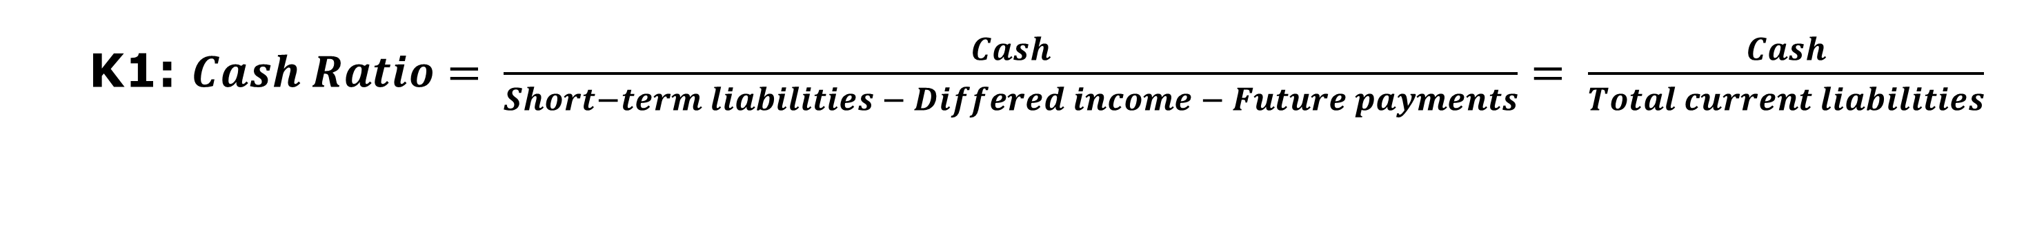
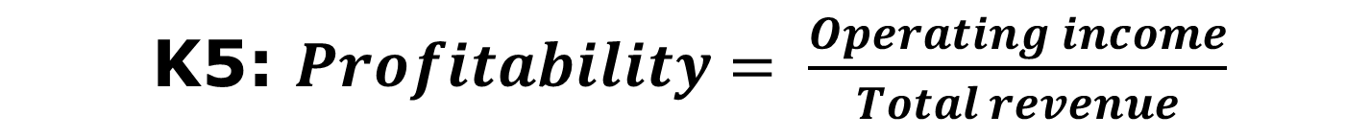
НИУ ВШЭ
Creditworthiness analysis: Sberbank methodology
NPM and GPM
K1: $Cash Ratio= \frac{Cash}{Short−term liabilities − Differed income − Future payments}= \frac{Cash}{Total current liabilities}$
K2: $Quick Ratio= \frac{Cash+Short−term financial investments+Accounts receivable}{Short−term liabilities − Differed income − Future payments}= \frac{Cash+Short−term financial investments+Accounts receivable}{Total current liabilities}$
K3: $Current Ratio= \frac{Total current assets}{Short−term liabilities − Differed income − Future payments}= \frac{Total current assets}{Total current liabilities}$
K4: $Leverage Ratio= \frac{Equity}{Short−term liabilities − Differed income − Future payments+Long−term liabilities}= \frac{Equity}{Total liabilities}$
K5: $Profitability= \frac{Operating income}{Total revenue}$

Slide 11
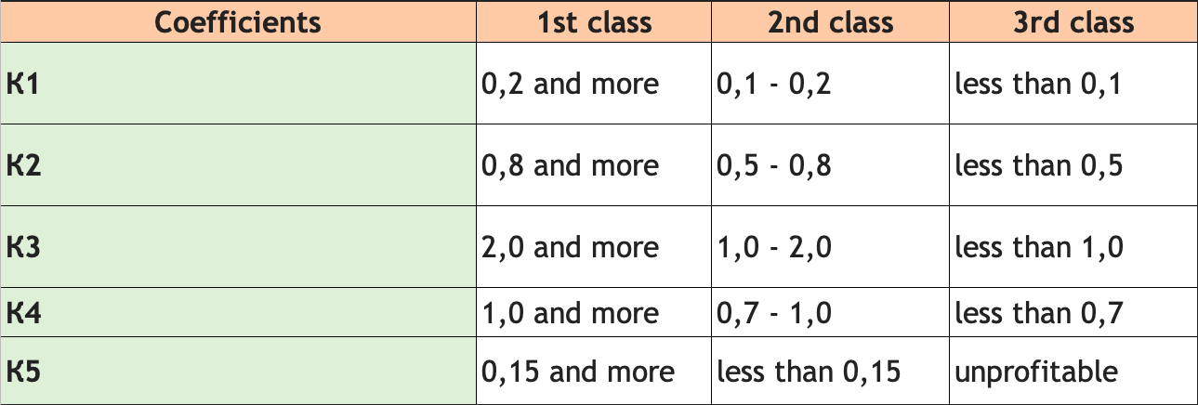
НИУ ВШЭ
Creditworthiness analysis: Sberbank methodology
NPM and GPM
𝑺=𝟎,𝟏𝟏 × 𝑲𝟏+𝟎,𝟎𝟓 × 𝑲𝟐+𝟎,𝟒𝟐 × 𝑲𝟑+𝟎,𝟐𝟏 × 𝑲𝟒+𝟎,𝟐𝟏 × 𝑲𝟓,
where S – rating number

Slide 12
НИУ ВШЭ
Results
S = 1 – 1,05 – first class of creditworthiness
1,05 < S < 2,42 – second class of creditworthiness
S ≥ 2,42 – third class of creditworthiness
Coefficients | Period ending: | 2018 | 2019 | 2020 | 2021
0.11 |  | 1 | 1 | 2 | 1
0.05 |  | 3 | 3 | 3 | 3
0.42 |  | 3 | 3 | 3 | 3
0.21 |  | 3 | 3 | 3 | 3
0.21 |  | 3 | 3 | 3 | 3
S |  | 2.78 | 2.78 | 2.89 | 2.78
Class |  | 3rd CLASS | 3rd CLASS | 3rd CLASS | 3rd CLASS

Slide 13

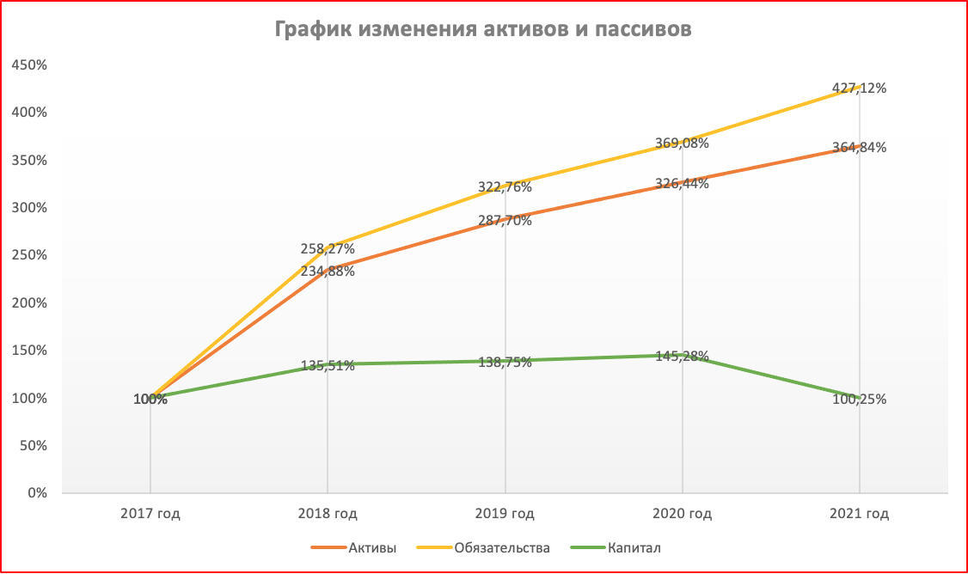
Horizontal analysis of the statement of financial position
Non-current assets increased by 670.69% Current assets increased by 166.71% Total assets increased by 264.84% Capital increased by 0.25% Total liabilities increased by 327.12%

Slide 14
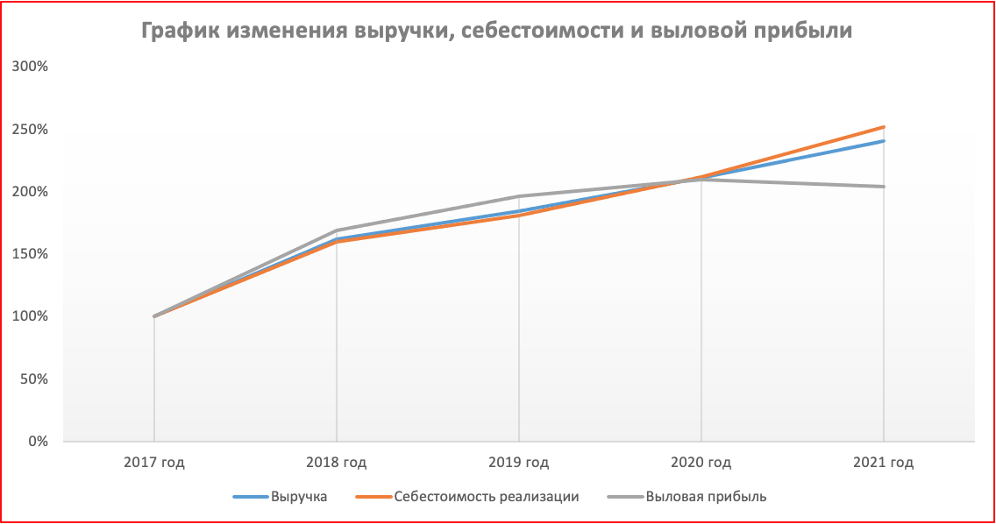
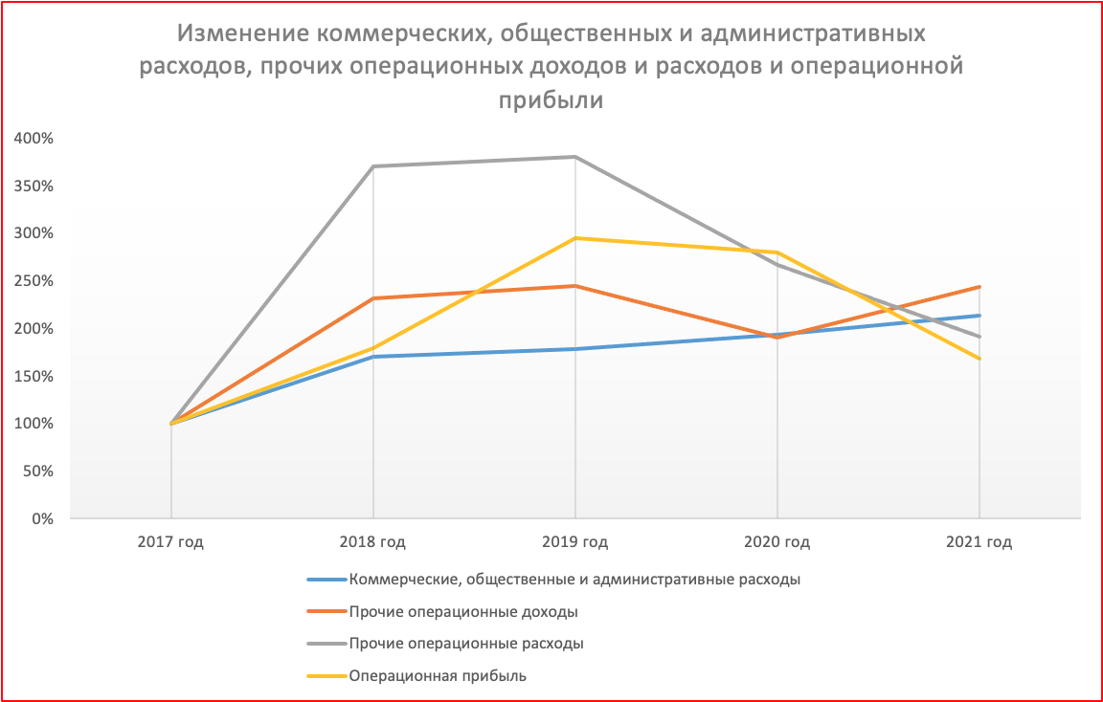
Horizontal analysis of the income statement
Revenue increased by 140.35% Cost of sales increased by 151.48% Gross margin increased by 104.06%
Operating profit increased by 68% Other operating income increased by 144.11% Other operating expenses increased by 91.67%

Slide 15
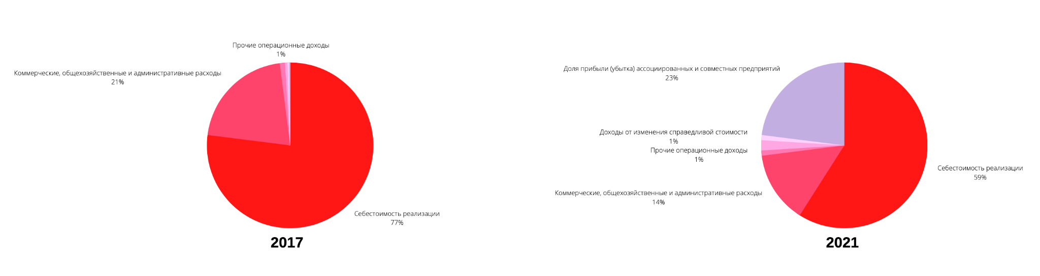
Vertical analysis
As in 2017, in 2021 the main share of revenue is the cost of sales - 77% and 59%, respectively. Commercial, general and administrative expenses decreased in 2021 The share of profits of associates and joint ventures increased significantly Most of the indicators remained unchanged or the changes are insignificant

Slide 16
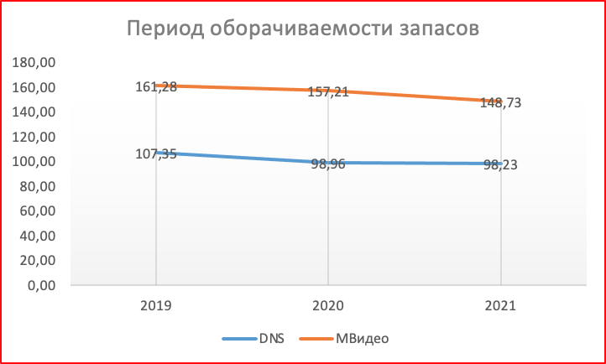
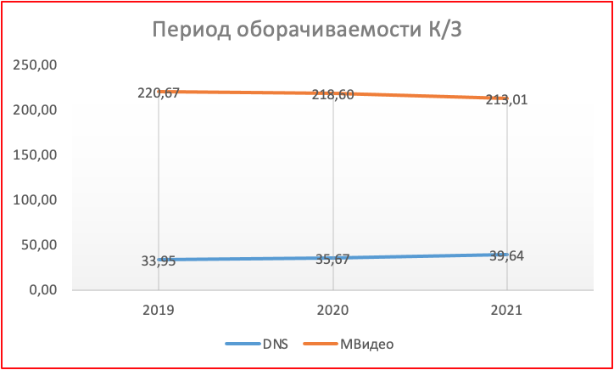
Quality of asset management
Inventory turnover period
Accounts payable turnover period

Slide 17
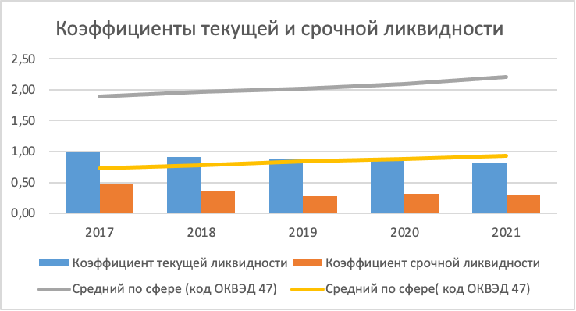
Current and term liquidity ratios
Current ratio decreased for 5 years (0.99 0.81) The derivatives ratio decreased by more than 35% over the same period (0.46 0.30) Average current liquidity in the sphere grew in the period 2017-2021 (1.89 2.21) The average term liquidity in the sphere also increased (0.73 0.93)

Slide 18
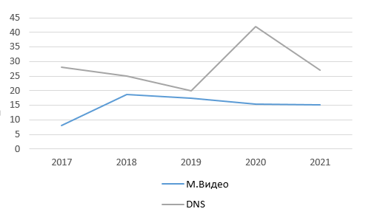
НИУ ВШЭ
Financial performance indicators of the company's activities
Return on equity, % (ROCE)
Value: shows the effectiveness of the use of borrowed and equity capital by the company.
Comparison with a competitor: lags behind the values of the coefficient of its competitor - DNS, which is 22.8% on average for 5 years.
Conclusion: in general, M.Video's capital ratio is of good importance, but it has the potential for growth.

Slide 19
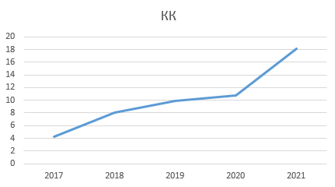
НИУ ВШЭ
Financial performance indicators of the company's activities
Capitalization ratio (QC)
Value: Capitalization ratio (QC) - shows the ratio of borrowed and own funds.
Conclusion: QC for the analyzed period increased from 4.25 in 2017 to 18.10 in 2021, which reflects a sharp increase in the company's dependence on borrowed sources of financing.

Slide 20
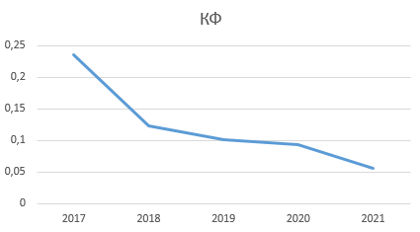
НИУ ВШЭ
Financial performance indicators of the company's activities
Funding Ratio (QF)
Significance: shows how much of the activity is financed from own funds, and how much is financed from borrowed funds.
Conclusion:QF for the analyzed period decreases from 0.24 in 2017 to 0.06 in 2021, which reflects an increase in the company's dependence on borrowed sources.

Slide 21
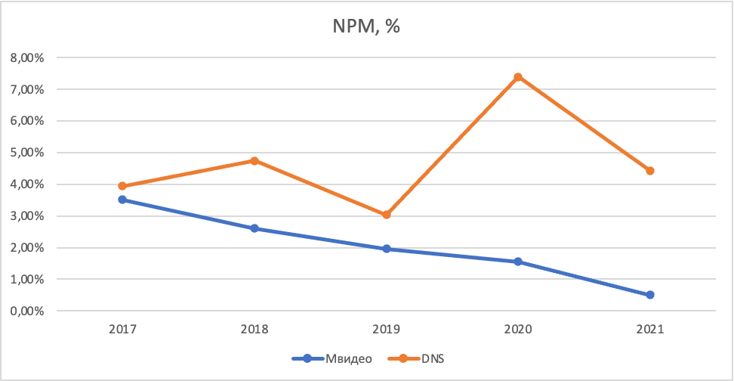
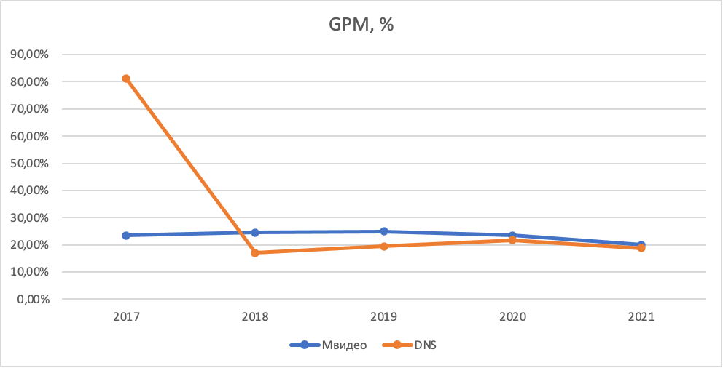
НИУ ВШЭ
Profitability ratios
NPM and GPM
Value: The NPM ratio shows how much net profit is contained in each ruble of sales. It is used for temporary analysis of the company's activities and comparison of companies in different industries. Meaning: The GPM indicator characterizes how much profit the enterprise received directly from sales, that is, before all other, related core activities, expenses and income are taken into account

Slide 22
НИУ ВШЭ
Conclusions
The results are contradictory, on the one hand, the Sberbank method shows disappointing results, and on the other hand, other analyzes show quite good, in aggregate I want to say about high financial stability and average creditworthiness.

Slide 23
